Slide 1
Workshop 3 Wikidata - Linked, Open Directories
Created and presented by
Inga Petri, Strategic Moves
January 26, 2022
1 pm to 2 pm Eastern

Slide 2
We live on the traditional territories of many Indigenous peoples
who have cared for this land since time immemorial.
Specifically, the Oneida and Chippewa Nations of the Thames, Kettle Point and Stony Point, and the Saugeen and Munsee Delaware Nations, are the traditional custodians of the land from which SpringWorks/Hermione Presents operates.
Strategic Moves operates on the Traditional Territories of the
Ta’an Kwäch’än Council and Kwanlin Dün First Nation,
self-governing nations that negotiated modern treaties (2002; 2005)
under the Umbrella Final Agreement between the 14 Yukon First Nations
and the Governments of Canada and Yukon.
Notes:
Replace with specific acknowledgement for the presenter – ie Montreal and workshops location

Slide 3
Notes:
Standard project slide for background and promote project website

Slide 4
P.A.D.E Workshop Series (2021 – 2022)
Fundamentals
Assessment: October 18 or 23
Website content: October 25
Social media content: November 1
Mastering Google: November 29
Review/Practice: December 4
Beyond Fundamentals
Assess Advanced SEO: January 12
Machine-readable content: January 15 or 19
Wikidata: January 26
Review/Practice:
January 29 or February 2
Digital Business / Revenue
Digital Value Chain: February 16 or 19
Hybrid Business Models: February 23
Digital Business Tools / Revenue Streams: March 9

Slide 5
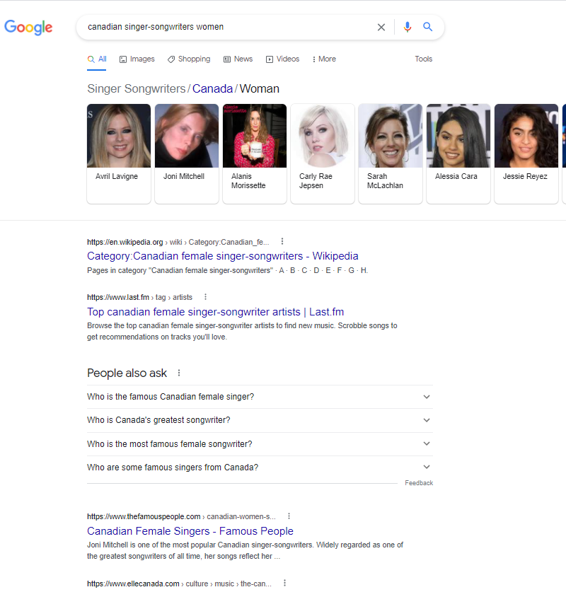
Discoverability
Capacity of something to be found, stumbled upon or recommended.

Slide 6
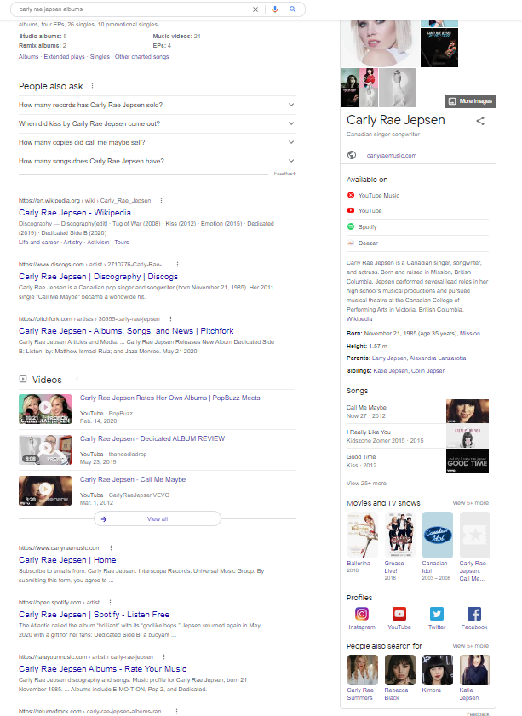
Discoverability
Capacity of something to be found, stumbled upon or recommended.

Slide 7
Important Web Directories
Wikidata (items, entities) https://www.wikidata.org
Wikimedia Commons (media files, images) https://commons.wikimedia.org
Artsdata.ca http://kg.artsdata.ca/ performing arts – emerging
Google Business Profile – Knowledge Panel
ISNI (names ID) https://isni.org/
MusicBrainz (open music encyclopedia) https://musicbrainz.org
Songkick (live shows) https://www.songkick.com
IMDb (movies) https://www.imdb.com/
Wikipedia (not a directory but an encyclopedia)

Slide 8
Benefits of Wikidata
Humans love Wikipedia. Machines love both Wikipedia and Wikidata.
Wikidata is the preferred knowledge base for search/answer algorithms and AI-powered tools such as personal assistants because they need access to an unlimited supply of simple and highly structured information.
How do you think search engines manage to display carousels of an artist’s works right on the answer page?
https://linkeddigitalfuture.ca/wikidata/

Slide 9
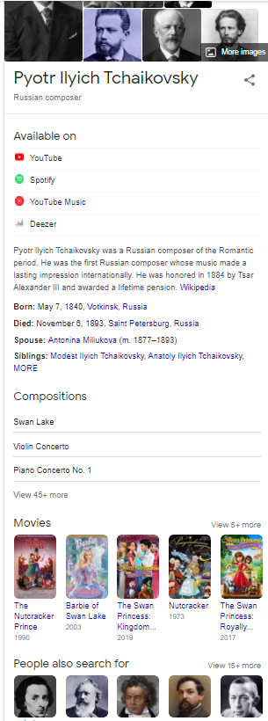
Google loves open knowledge bases
Google relies on many open knowledge bases and content repositories to generate rich results and to populate knowledge cards.
Google:
Displays a short summary from Wikipedia
Pulls basic factual information from Wikidata
Retrieves photos from Wikimedia Commons
Wikimedia projects are by no means the only sources of information and content for Google. But they are accessible, easy and powerful platforms for anyone wishing to participate in them
https://linkeddigitalfuture.ca/wikidata/

Slide 10
Wikipedia → Wikidata item

Slide 11
Wikidata
Knowledge base 91 million items
~31% scientific
~9% are human – tons of opportunity for arts!
Accessible to everyone to edit, contribute, use
Reusable – free Creative Commons licence
Acts as central storage for the structured data of its Wikimedia sister projects including Wikipedia and others and BEYOND
https://www.wikidata.org/wiki/Wikidata:Main_Page
https://www.wikidata.org/wiki/Q15673471 (Lyndie Greenwood)
https://www.wikidata.org/wiki/Q7422551 (Sarah MacDougall)
https://linkeddigitalfuture.ca/wikidata/ series of workshops by CAPACOA, CTQ

Slide 12
Wikidata – Key concepts
Item or entity (anyone can create)
unique ID
Property (restricted by a collaborative process)
Nutcracker composer Tchaikovsky
Value
Tchaikovsky (an item) is the value
Values can also be numbers: date, geo coordinates, link to an image in Wikimedia commons
Statement
Item + property + value
https://linkeddigitalfuture.ca/wikidata/ series of workshops by CAPACOA, CTQ

Slide 13
Wikimedia Commons
66 million freely usable media files to which anyone can contribute
Media file repository
https://commons.wikimedia.org/wiki/Commons:Welcome

Slide 14
Wikipedia A trusted source for Google used in your knowledge panel, top search result Unbiased, non-commercial, community publishing standards are stringent Do not get blacklisted!

Slide 15
Wikipedia – Five Principles
It is an encyclopedia (not a soap box, advertising vehicle, directory)
Neutral point of view – verifiable, citations
Free content that anyone can use, edit and distribute
Editors to treat each other with respect and civility
No firm rules – but clear policies and guidelines
https://en.wikipedia.org/wiki/Help:Introduction
https://en.wikipedia.org/wiki/Help:Introduction_to_policies_and_guidelines/2
https://en.wikipedia.org/wiki/Wikipedia:Policies_and_guidelines

Slide 16
Wikis are crowdsourced and thus edit history is transparent and reside alongside the article

Slide 17
Beyond Fundamentals
Assess Advanced SEO: January 12
Machine-readable content: January 15 or 19
Wikidata: January 26
Review/Practice:
January 29 or February 2

Slide 18
https://digitalartsnation.ca/digital-playbook/mastering-discoverability-for-the-performing-arts/

Slide 19
LET’S STAY IN TOUCH
Inga Petri
Strategic Moves
Whitehorse, Yukon
www.strategicmoves.ca
ipetri@strategicmoves.ca
613.558.8433 (mobile, Canada-wide)
@ipetri

