Slide 1
Workshop 1 Advanced Search Engine Optimization
Created and presented by
Inga Petri, Strategic Moves
January 12, 2022
1 pm to 2:15 pm Eastern

Slide 2
We live on the traditional territories of many Indigenous peoples
who have cared for this land since time immemorial.
Specifically, the Oneida and Chippewa Nations of the Thames, Kettle Point and Stony Point, and the Saugeen and Munsee Delaware Nations, are the traditional custodians of the land from which SpringWorks/Hermione Presents operates.
Strategic Moves operates on the Traditional Territories of the
Ta’an Kwäch’än Council and Kwanlin Dün First Nation,
self-governing nations that negotiated modern treaties (2002; 2005)
under the Umbrella Final Agreement between the 14 Yukon First Nations
and the Governments of Canada and Yukon.
Notes:
Replace with specific acknowledgement for the presenter – ie Montreal and workshops location

Slide 3
Notes:
Standard project slide for background and promote project website

Slide 4
P.A.D.E Workshop Series (2021 – 2022)
Fundamentals
Assessment: October 18 or 23
Website content: October 25
Social media content: November 1
Mastering Google: November 29
Review/Practice: December 4
Beyond Fundamentals
Assess Advanced SEO: January 12
Machine-readable content: January 15 or 19
Wikidata: January 26
Review/Practice:
January 29 or February 2
Digital Business / Revenue
Digital Value Chain: February 16 or 19
Hybrid Business Models: February 23
Digital Business Tools / Revenue Streams: March 9
Notes:
Review a report in full – refer them to other soruces

Slide 5
Homework Review
Go to https://seositecheckup.com/
Enter your website url in the open field and click on Checkup
Wait for the report, save it, read it

Slide 6
From Search to Discoverability
Being online
Search Engine Optimization (SEO) - Keywords
Answers
Discoverability
Your website
Searching
Advanced SEO – Technical SEO, Structured meta data standards
Linked open data directories

Slide 7
Search engine rankings of web pages thrive on content
Consistent publishing of high quality content
Niche expertise
User engagement
Mobile optimised
Next – voice-based web assistants will increase in dominance

Slide 8
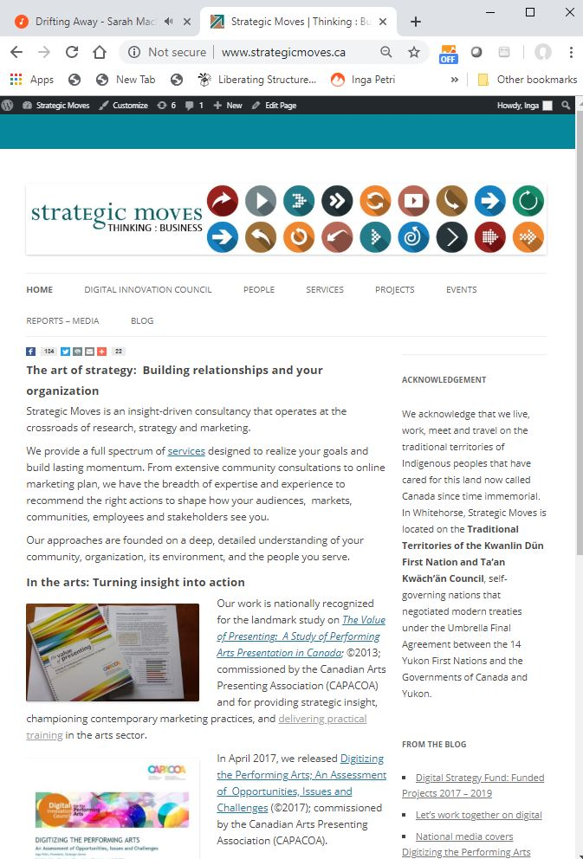
Website info determines search result
https://seositecheckup.com/seo-audit
Notes:
10:50

Slide 9
Keywords rule – per page
Domain name URL use real words
URL page names
Title tags
Headlines (h1, h2 …)
Image Alt tags
Description meta tag
Suggested keyword formula
Your town, province
Performing arts
Entertainment
Music
Potentially include genres
Theatre
Dance
Concerts
Show
Play
Performance
Bands/Artists names
Play title
Known parts of show (e.g. Shakespeare)

Slide 10
Traditional SEO Keywords Coded for Search Engines
URL (uniform resource locator) = web address
Use words not acronyms or numbers
URL page names
Each service / product / experience on own page
Use relevant keywords
Title tags
Appears on browser tab
Search engine / Facebook uses them as the header in search listing
Headlines (h1 tag sets content)
Image Alt tags
Use the “image ALT” text for keyword-rich descriptive text
Description meta tag
This is a real summary sentence for a specific page
Search engines, and other sites, can use them in result displays
Notes:
Demonstrate DigitalArtsNation and ThePitch, Strategic Moves – re interplay of Yoast SEO and Text, Images

Slide 11
Technical SEO
Backlinks - Link to other websites, trusted sites link to yours
Internal links
Fast load times (no high res images, no autoplay videos)
SSL encryption (secure socket layer) https://
Sitemap.xml
Robot.txt
Set up web analytics and monitor and adjust

Slide 12
Moving from searching to discovering

Slide 13
From searching to getting answers

Slide 14
Advanced SEO
Semantic web – web of data
Semantic simply refers to the meaning of a word, text or phrase.
Become the answers
Enables the speakable web
Structured Data – schema.org for search engines
Standardized protocols and meta-data tags that allow them to consistently and reliably understand the content of websites and use it to provide answers
Google Events
Discoverability
The capacity to be found – enhanced by supplying structured data in a standardized way so machines can read it.

Slide 15
LET’S STAY IN TOUCH
Inga Petri
Strategic Moves
Whitehorse, Yukon
www.strategicmoves.ca
ipetri@strategicmoves.ca
613.558.8433 (mobile, Canada-wide)
@ipetri

