Slide 1
Workshop 3
Hybrid Business Models
Created and presented by
Inga Petri, Strategic Moves
March 9, 2022
1 pm to 2:15 pm Eastern

Slide 2
Acknowledgement
We wish to honour the Anishinaabe, the Haudenosaunee Confederacy, the Wendat, and the Neutral Nation who are the traditional custodians of the land upon which we stand and the waters that flow through it. It is our privilege to share this land, which has been the site of imagination since the beginning of human experience.
Hermione Presents ~ SpringWorks is located on land governed by both the Dish With One Spoon Wampum Belt Covenant of 1701 and the Huron Tract Treaty of 1827. We are mindful of broken covenants and the need for us to respectfully listen, to learn from our mutual history and to strive continuously for reconciliation at all levels.
The responsibility to nurture this land and protect the future falls to us all and in so doing, we actively honour the wisdom of those who came before us.
Strategic Moves operates on the Traditional Territories of the Ta’an Kwäch’än Council and Kwanlin Dün First Nation, self-governing nations that negotiated modern treaties (2002; 2005) under the Umbrella Final Agreement between the 14 Yukon First Nations and the Governments of Canada and Yukon.

Slide 3
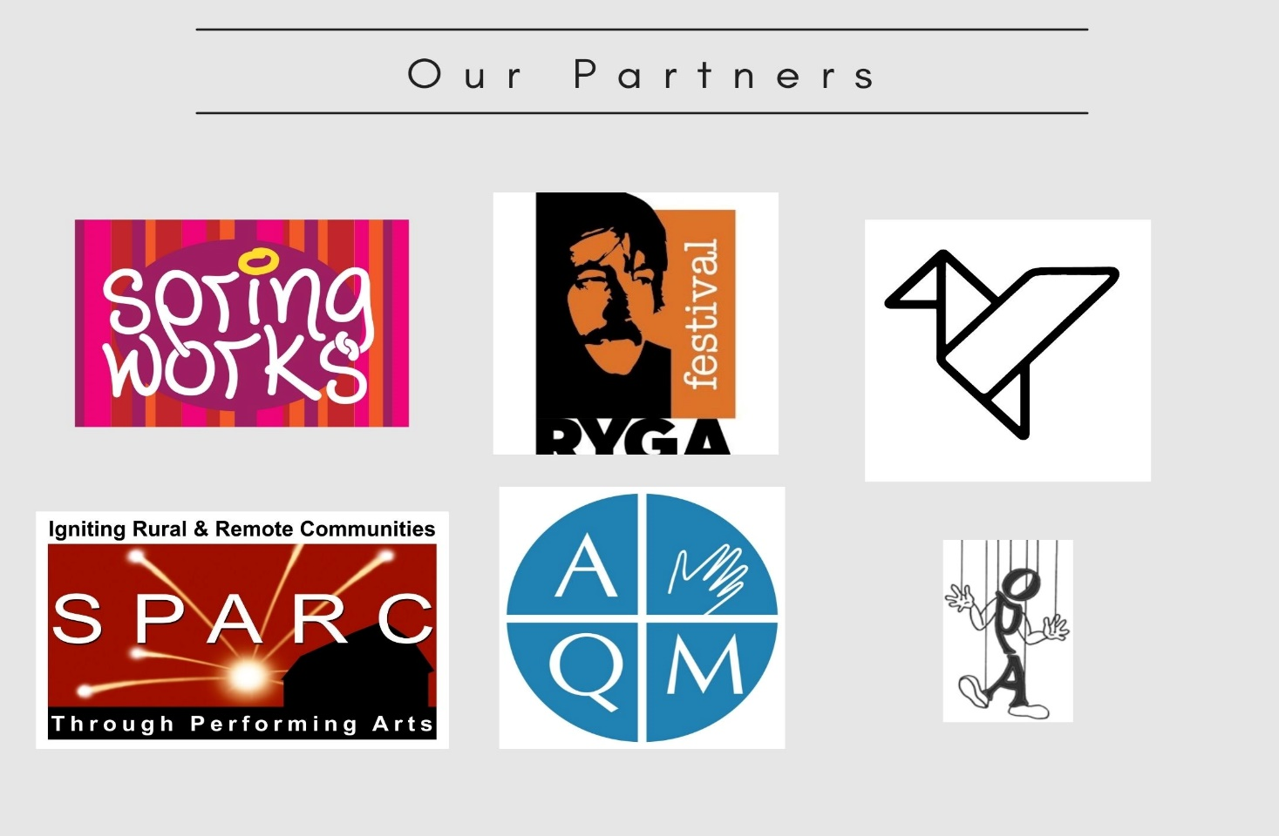

Notes:
Standard project slide for background and promote project website

Slide 4

P.A.D.E Workshop Series (2021 – 2022)
Fundamentals
  Assessment: October 18 or 23
  Website content: October 25
  Social media content: November 1
  Mastering Google: November 29
  Review/Practice: December 4
Beyond Fundamentals
  Assess Advanced SEO: January 12
  Machine-readable content: January 15 or 19
  Wikidata: January 26
  Review/Practice:
  January 29 or February 9
Digital Business / Revenue
Digital Value Chain: February 16 or 19
Hybrid Business Models: February 23
Digital Business Tools / Revenue Streams: March 9

Slide 5
Digital Disruption → Big Questions
What should a Canadian digital
performing arts eco-system look like?
How is revenue generated and shared
in the digital world?
Notes:
2:55

Slide 6
Data Strategy Initiatives
Digital Data Standards
Arts Services
Know-how (literacy and intelligence)
Equity, diversity and inclusion
Business-to-Business Collaboration
Enabling Business Transactions and Relationships
Business-to-Consumer
Enabling Revenue Models for Digital Presentation and Dissemination

Slide 7


Digital Know-How and information, workshop libraries
https://digitalartsnation.ca/digital-playbook/
This initiative brings practical digital know-how to participants across Canada, through custom workshops, online how-to tutorials and information-sharing. You will learn how to assess your actual digital footprint and how to use digital tools and methods to best effect, including semantic web / structured data, linked data.
Geared toward managing directors, programmers, marketers, box office staff and webmasters alike, the workshops help participants 'speak digital' with confidence and join in sector-wide conversations about leading digital tools, emerging digital innovations, and new digital business models.
https://www.digarts.ca
Here are some digital resources prepared by our team as an output of the IT assessment and optimization process.
Increase access to digital tools, resources and skills for puppeteers, multidisciplinary artists and arts organizations.
https://www.springworksfestival.ca/pade

Slide 8
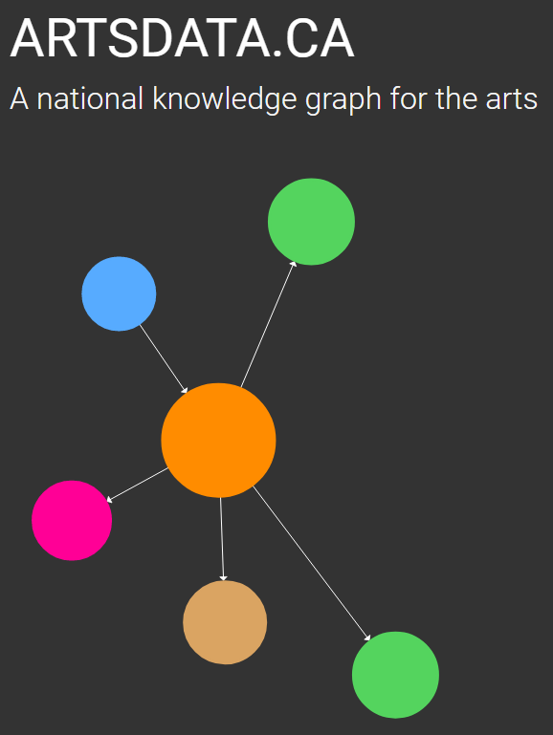

Several emerging data strategy enablers
The BIG Players
Google
Schema.org
W3C
Wikimedia
Canadian Data Initiatives
Knowledge Graph for the Arts: Digital access, agency and transformation
ArtsData.ca is centred on making the process simple for arts organizations and artists to generate, maintain, link, structure and share machine-readable metadata about their events and activities. In an AI-powered world, linked structured data is critical for discoverability.

Slide 9

Several emerging data strategy enablers
Canadian Data Initiatives
Performing Arts Genome
The Performing Arts Genome Project is tackling two main challenges: a) modeling the individual dimensions, or “genes,” that dictate our preferences for live arts, such as genres, mood, tone, form, content and features, and b) measuring the collection of genes, the “genome,” for companies, artists, venues and works of live performance using a combination of machine learning and manual curation. This work has a number of applications, including matching algorithms, recommender systems and discovery tools that help people find work that fits their taste profile and needs.
LDFI seeks to enhance the discoverability of the performing arts. Our goal is to help the sector leverage the potential of linked data technologies and to foster collaboration along the performing arts value chain. There are five areas of focus.

Slide 10




Several emerging data strategy enablers
An open source Arts Resource Planning (ARP) software solution that serves as the core technology for Artse United - digital platform cooperative empowering financial, business intelligence, and impact investing management for small creators and producers across multiple disciplines.
What does a positive digital future look like to you? And, what are the roles of arts services in helping us get there?
ARTSPOND

Slide 11

https://amsnetwork.ca/
Cloud-Based Management Software For Arts Organizations, Built from the ground up by artists for artists, co-op structure.
All-in-one, web-based platform for member-based artist centres, spearheaded by Film and Video Arts Society (FAVA)

Slide 12


B2B
Online application form used by about 15 presenting networks that act as physical market places for the performing arts. Focussed on music and rural Canada usually.
Purpose: Digital Marketplace for the Performing Arts where the selling side (artists and agents) and the buying side (presenters, venues and presenting networks) can discover each other and do business. Help artists develop current performance videos for editing and use on the Pitch.
In Beta launch mode still – complete in next 2 weeks then full launch in April
BLOCK BOOKING
New tool that is designed for presenting networks to facilitate block booking. In development. Unclear whether it will become a tool for broader use.

Slide 13

New project in ideation stage
Replacing Marcato festival event management tool
Looking at building a digital platform to share information between touring artists and host network on specific tours: schedule, technical needs, marketing, financial settlement etc.
One-stop shop, web interface, social media in

Slide 14
The Big Players in Dissemination Platforms
YouTube
Vimeo
Facebook
Instagram
Zoom
Issue:
These platform generate large revenue streams from your content. Nearly impossible to generate revenue for your own work.
Solution:
Platform ownership is key to revenue generation

Slide 15



B2C
    Aspiration: The World’s Marketplace for artists, hosts and audiences
    Purpose: Ticketing and Zoom platform integration for live events
    https://sidedooraccess.com/home
    Aspiration: Keep Money in pockets of creators
    Purpose: Digital distribution of video recordings after an event, with ability to unbundle shows into shorter segments, by song. Also partnership with Telus Optik for distribution https://www.thepublicplace.online/en/
Performing arts intelligence company and data platform based in Toronto, Canada. We specialize in personalized recommendation solutions for audiences. Our mission is to increase the vibrancy and sustainability of the performing arts industry by connecting audiences with great performance. https://www.stagepage.ca/

Slide 16
P.A.D.E Workshop Series (2021 – 2022)
Fundamentals
  Assessment: October 18 or 23
  Website content: October 25
  Social media content: November 1
  Mastering Google: November 29
  Review/Practice: December 4
Digital Business / Revenue
Digital Value Chain: February 16 or 19
Hybrid Business Models: February 23
Digital Business Tools / Revenue Streams: March 9
Beyond Fundamentals
  Assess Advanced SEO: January 12
  Machine-readable content: January 15 or 19
  Wikidata: January 26
  Review/Practice:
  January 29 or February 9
Community of Practice working meetings
Activate community of practice
Consult on digital opportunities, March to May 2022

Slide 17
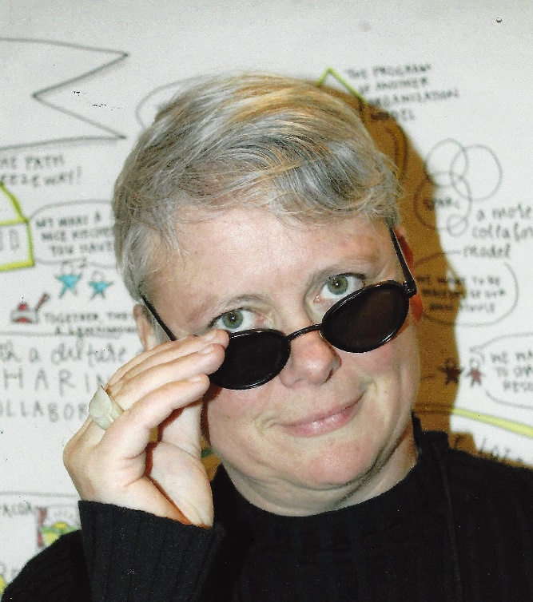
LET’S STAY IN TOUCH
Inga Petri
Strategic Moves
Whitehorse, Yukon
www.strategicmoves.ca
ipetri@strategicmoves.ca
613.558.8433 (mobile, Canada-wide)
@ipetri

