Slide 1
Workshop 4 Mastering Google
Created and presented by
Inga Petri, Strategic Moves
November 29, 2021
1 pm to 2:15 pm Eastern

Slide 2
We live on the traditional territories of many Indigenous peoples
who have cared for this land since time immemorial.
Specifically, the Oneida and Chippewa Nations of the Thames, Kettle Point and Stony Point, and the Saugeen and Munsee Delaware Nations, are the traditional custodians of the land from which SpringWorks/Hermione Presents operates.
Strategic Moves operates on the Traditional Territories of the
Ta’an Kwäch’än Council and Kwanlin Dün First Nation,
self-governing nations that negotiated modern treaties (2002; 2005)
under the Umbrella Final Agreement between the 14 Yukon First Nations
and the Governments of Canada and Yukon.
Notes:
Replace with specific acknowledgement for the presenter – ie Montreal and workshops location

Slide 3
Notes:
Standard project slide for background and promote project website

Slide 4
P.A.D.E Workshop Series (2021 – 2022)
Fundamentals
Assessment: October 18 or 23
Website content: October 25
Social media content: November 1
Mastering Google: November 29
Review/Practice: December 4
Beyond Fundamentals
Assess Advanced SEO: January 12
Machine-readable content: January 15 or 19
Wikidata: January 26
Review/Practice:
January 29 or February 2
Digital Business / Revenue
Digital Value Chain: February 16 or 19
Hybrid Business Models: February 23
Digital Business Tools / Revenue Streams: March 9

Slide 5
Homework Review
How does Google see you?

Slide 6
Google MyBusiness
Own your MyBusiness account
Connect with clients in search and maps
Post photos, events, updates, one click phone and web access
Links on posts
Reviews
Insights

Slide 7
Our focus today
Google MyBusiness
Google Maps
Google Search
Google Events and Answer boxes
Google Assistant, Siri, Alexa
Notes:
10:44

Slide 8
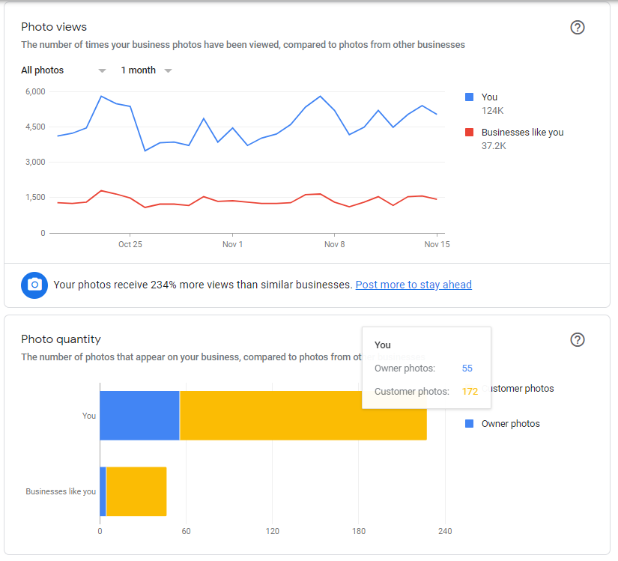
Photos are important
From Google My Business Insights:
Photo views and customer photos versus company posted photos.

Slide 9
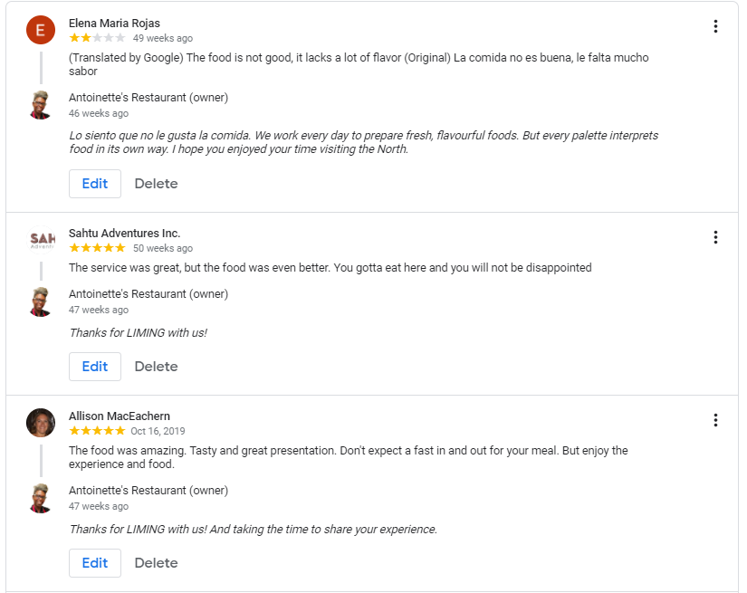
Reviews rule
Google My Business:
Reviews are real – keep an eye on them and respond to them! Especially any negative ones.

Slide 10
Google MyBusiness
Review and improve your MyBusiness account
Set up your MyBusiness account following the steps by Google
Google Maps listing – another way to claim or set up your Google MyBusiness account

Slide 11
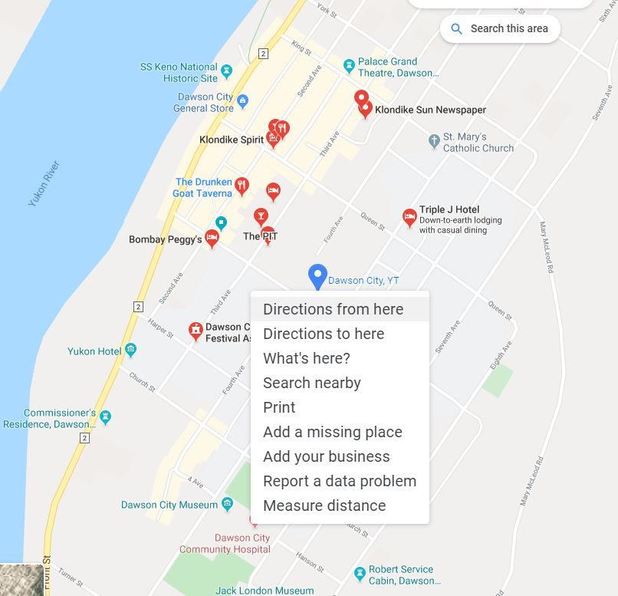
Maps can bring more exposure than search
On your computer, left click with your mouse on your address / pin to get this contextual drop down

Slide 12
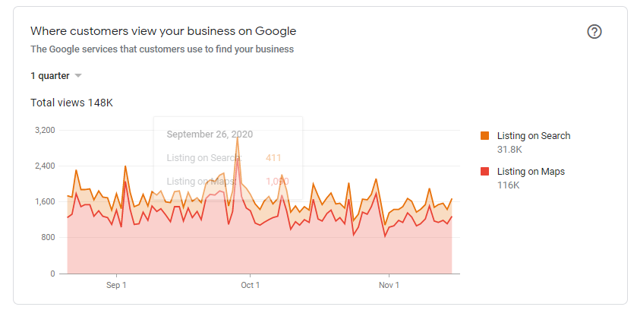
Maps can bring more exposure than search
From Google My Business Insights

Slide 13
Writing your web site for people
Authentic voice
Connect your purpose with audience motivations
Start with 8 to 12 important keywords
Balance: interesting read that flows well with consistent keywords
Second tier keywords important in body text, because first tier keywords dominant in structure
Make the page easy to scan
Consistent headings and short paragraphs
Editorial use of images, video
Minimize ‘features’ in body text, like colour, bold, underline, italics; they make reading harder

Slide 14
Traditional SEO Coding for Search Engines
URL (uniform resource locator) = web address
Use words not acronyms or numbers
URL page names
Each service / product / experience on own page
Use relevant keywords
Title tags
Appears on browser tab
Search engine uses them as the header in search listings
Facebook does, too
Headlines (h1 tag imperative)
Image Alt tags
Use the “image ALT” text for keyword-rich descriptive text
Description meta tag
This is a real summary sentence for a specific page
Search engines, and other sites, can use them in result displays
Notes:
Demonstrate DigitalArtsNation and ThePitch, Strategic Moves – re interplay of Yoast SEO and Text, Images

Slide 15
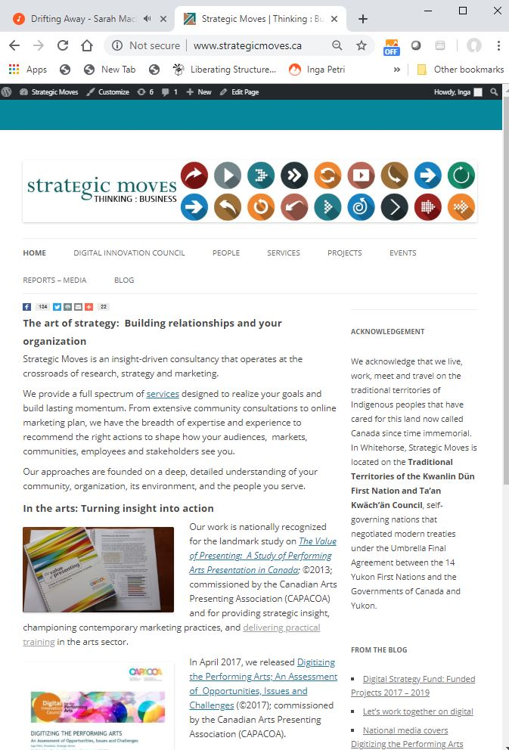
Website info determines search result
https://seositecheckup.com/seo-audit
Notes:
10:50

Slide 16
Traditional SEO
Also watch out for these essentials for best ranking for web pages:
Fast load times (no high res images, no autoplay videos)
SSL encryption (secure socket layer) https://
Sitemap.xml
Robot.txt
Link to other websites, encourage trusted sites to link to yours
Set up web analytics from the start and monitor and adjust

Slide 17
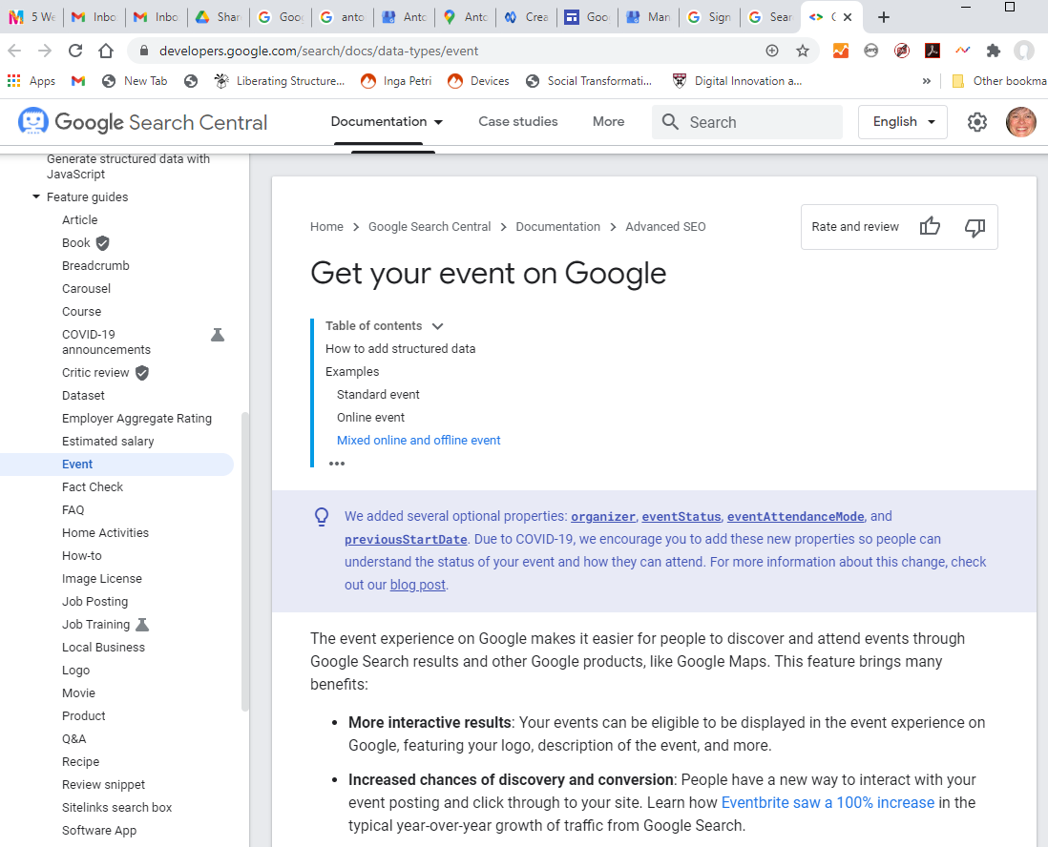
Google Events
Search What’s On in [your town, your region, your province]
Consider the results
Event info on Google

Slide 18
Google Events listings have changed a lot
To have your events listed in these Google event results, they must use structured data.

Slide 19
Google Events listings have changed a lot
Sites that use your content might use structured data, e.g. Eventbrite, Ticket engines, Facebook events, so your events will show up here.

Slide 20
Google Answer boxes
Added potential benefit: Using structured data on your site, means Google might select your content for its answer boxes, too.

Slide 21
What does it mean to you when Google gives answers?
Might bypass your website entirely … soon
Google displays what it consider the best answer
Answer boxes are informational not commercial so not an ad option
Google considers unbiased, trusted sites as sources – Wikipedia, .edu and similar often appear
For brand information most trusted should be the brand’s website
Web content is extracted by Google

Slide 22
Steps to position yourself as the answer
Keywords and phrases
Respond to specific questions and include them in the text or description meta tag
Write great content, straightforward information, to the point
Structure your content well – structured data mark up creates a rich snippet
No guarantees Google will use it

Slide 23
VOICE! A heads up
As more and more people are using voice-based assistants - like Siri, Alexa, Google Assistant - you have to consider how you need to adjust or re-write your content to be spoken.
These AI tools use natural language processing to form sentences.
Especially important when you consider event information.
Structured meta-data mark up allows for text to be spoken; additionally, there are now tools in some WordPress plug ins to designate the “speakable” text on a page

Slide 24
Fundamentals
Assessment: October 18 or 23
Website content: October 25
Social media content: November 1
Mastering Google: November 29
Review/Practice: December 4

Slide 25
LET’S STAY IN TOUCH
Inga Petri
Strategic Moves
Whitehorse, Yukon
www.strategicmoves.ca
ipetri@strategicmoves.ca
613.558.8433 (mobile, Canada-wide)
@ipetri

