Slide 1
Workshop 3 Truly Engaging: How to Create Social Media Posts that Connect
Created and presented by
Inga Petri, Strategic Moves
November 1, 2021
1 pm to 2:15 pm Eastern

Slide 2
We live on the traditional territories of many Indigenous peoples
who have cared for this land since time immemorial.
Specifically, the Oneida and Chippewa Nations of the Thames, Kettle Point and Stony Point, and the Saugeen and Munsee Delaware Nations, are the traditional custodians of the land from which SpringWorks/Hermione Presents operates.
Strategic Moves operates on the Traditional Territories of the
Ta’an Kwäch’än Council and Kwanlin Dün First Nation,
self-governing nations that negotiated modern treaties (2002; 2005)
under the Umbrella Final Agreement between the 14 Yukon First Nations
and the Governments of Canada and Yukon.
Notes:
Replace with specific acknowledgement for the presenter – ie Montreal and workshops location

Slide 3
Notes:
Standard project slide for background and promote project website

Slide 4
P.A.D.E Workshop Series (2021 – 2022)
Fundamentals
Assessment: October 18 or 23
Website content: October 25
Social media content: November 1
Mastering Google: November 29
Review/Practice: December 4
Beyond Fundamentals
Assess Advanced SEO: January 12
Machine-readable content: January 15 or 19
Wikidata: January 26
Review/Practice:
January 29 or February 2
Digital Business / Revenue
Digital Value Chain: February 16 or 19
Hybrid Business Models: February 23
Digital Business Tools / Revenue Streams: March 9

Slide 5
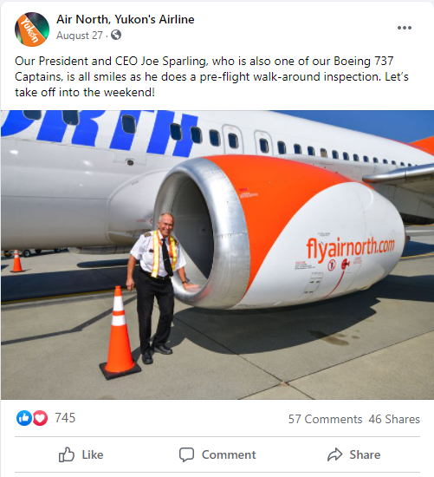
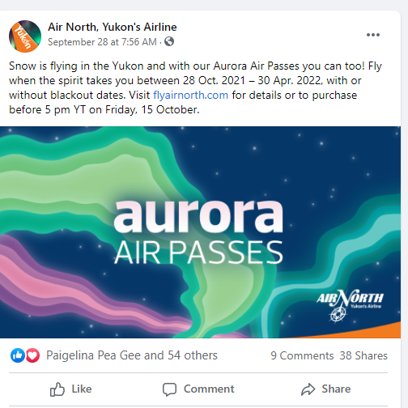
Homework Review
Characteristics of highly engaging posts and those that didn’t gain high engagement

Slide 6
You are a …
Photographer and photo editor
Video director, star and video editor
Writer and editor
Have you got what it takes?
Let’s take a heuristics approach to finding out!
Notes:
2:06
“A heuristic is any approach to problem solving, learning, or discovery that employs a practical method not guaranteed to be optimal or perfect, but sufficient for the immediate goals.”

Slide 7
Your audience
Fans love you
Feel a sense of belonging
Have expectations
Love colours their experience
May feel let down if experience doesn’t live up to expectations
Returning audiences like you
Familiarity
Their last experience colours the next one
Hope you will not only meet but exceed expectations
New audiences don’t know you
Not sure if this is for them. May feel out of place.
May expect something quite different than you have to offer
Fear wasting time / attention / money on something that isn’t for them
Rely on first impressions (branding), critic reviews, word-of-mouth, or chance to determine whether to give it a try

Slide 8
Respect your audience’s purpose
Facebook: To stay in touch with people you know IRL, or who share your interests
Friends, family, and ‘weak ties’
Community groups (places, interests)
Content curated by your connections: read articles, watch videos, look at pictures
Live video
Games, events, birthday notifications
Business pages, marketplaces
YouTube: To be entertained, to learn, to explore, or to broadcast yourself
Find content via search, social shares
Subscribe to favourite YouTubers
Successful channels have their own identities and communities
SEO relevance
Twitter: To share your opinions or what you are doing
Microblogging, text
Hashtag #
News and links
Followers
Instagram – To find inspiration in the ‘highlights reel’ of the lives of others
Selfies, photos
Hashtag #
#nofilter

Slide 9
Know your purpose
Facebook: To inspire your fans to tell their friends about you. To learn about your audience. To target your message to a specific audience.
Contribute content that people want to like, comment on, or share
Video (esp. live) and photo content is essential
Long-form content (articles) and well-crafted text updates can do well, too
Participate in community groups (places, interests), or create your own if you have the time to nurture that
Promote events
Sell shows, merch
Run targeted ads to promote content
YouTube: To entertain or to teach
Optimize for SEO
Build a following
Monetization features
Twitter: To be part of the conversation
Spotlight expertise
Find out what others are saying about a place or topic
Instagram – To inspire. To share a glimpse into your world.
Selfies, photos
Hashtag #
#nofilter

Slide 10
Content development: The 3 Cs
Creation: write, make videos, take pictures, record podcasts, produce illustrations or infographics …
Curation: Shine a spotlight on other people’s work, share relevant, insightful, or inspiring content from your work or experiences …
Conversation: Interview actors, puppeteers, expert; ask your audience a question, best if its serious; respond to comments; be polite; have fun; join a conversation via hashtags …
Notes:
Define your ideal mix, based on your purpose, audience, and resources.

Slide 11
Be creative
Learn from what others do well, but you won’t stand out unless you do something different
Listen to what your audience wants, but pay more attention to what they actually do or need

Slide 12
Skills: Photography
Composition
Rule of thirds
Symmetry
Reflections
Repeating patterns
Focus on one subject (simplify or blur background)
Crop to fill the frame
Unusual perspectives (aim high or low, zoom in or way out)
Diagonal lines
Quality
Crop instead of zoom (unless you have pro camera)
Get a tripod and mount your phone
Take advantage of camera functions (panorama, portrait mode)
Take many pics and select the best to edit and post
#nofilter
Content
Current / timely
Candid shots – faces draw attention and we follow their gaze
Don’t post complete images of final visual art pieces that can be reproduced/printed
https://www.quicksprout.com/2018/12/01/12-tips-for-taking-better-marketing-photos-for-your-social-media-campaigns/

Slide 13
Skills: Video
Composition
Lighting – lots of light – especially on faces
Natural sunlight works well, try for softer light parts of the day
Clean, uncluttered background
Rule of thirds
Quality
Crisp, clear audio, make sure you have a good microphone
No shaky footage, use tripod.
Use your smart phone – back camera is better, horizontal recording not vertical
Use a good video editing program
Keep editing simple, focus on clean up (especially audio/noise reduction) and transitions
Use angles, cut aways to create visual interest
Content
Script or storyboard your videos
Make sure your subject has the right on-camera presence: open body language, smile, speak slightly slower
Notes:
3:10 to 3:20
www.wave.video/blog/viode marketing 12 simple tips for making videos look more professional

Slide 14
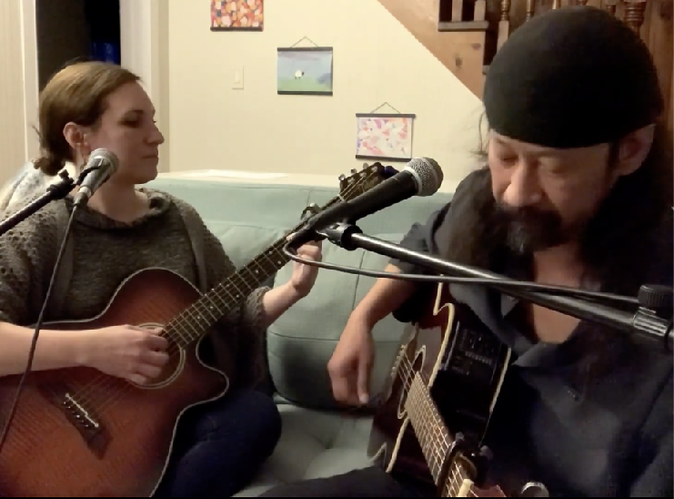
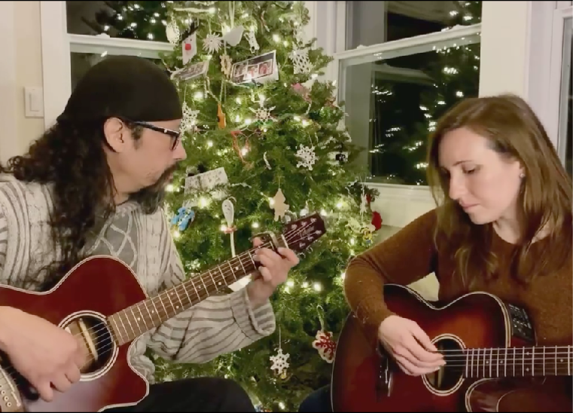
Video quality: light, mic & background
Don’t wait until it’s perfect
Don’t assume what will connect with audiences, test it out

Slide 15
Skills: Writing
Composition
Define and hone your voice
Voice: be casual, conversational, talk to me directly, positive, upbeat, fun
Use I, we, you instead of the organization, the team
Use emoji to show your point and increase engagement
Use hashtags on Twitter and Instagram
Quality
Short sentences, short words
40 characters makes a long Facebook post in many cases
Link to your blog, gallery, videos and other long form, don’t paste its content into Facebook status
It’s ok to break some punctuation rules, but do check spelling and grammar
Content
Call to action but don’t over-promote and don’t sell when you are building a social relationship
Short questions can be great lead ins
Research tells you who you are writing for – use it!
Write great captions for your images
Notes:
2:55 to 3:10
Look at Antoinette’s and the backend to it.

Slide 16
Fundamentals
Assessment: October 18 or 23
Website content: October 25
Social media content: November 1
Mastering Google: November 29
Review/Practice: December 4
Week 1: Digital Inclusion
Week 2: The Emerging Digital Performing Arts eco-system
Week 3: Ways forward and Digital Technologies to Watch

Slide 17
LET’S STAY IN TOUCH
Inga Petri
Strategic Moves
Whitehorse, Yukon
www.strategicmoves.ca
ipetri@strategicmoves.ca
613.558.8433 (mobile, Canada-wide)
@ipetri

