Slide 1
Workshop 2 Machine-Readable Content
Created and presented by
Inga Petri, Strategic Moves
January 15, 2022
January 19, 2022 (repeat)
1 pm to 2:30 pm Eastern

Slide 2
We live on the traditional territories of many Indigenous peoples
who have cared for this land since time immemorial.
Specifically, the Oneida and Chippewa Nations of the Thames, Kettle Point and Stony Point, and the Saugeen and Munsee Delaware Nations, are the traditional custodians of the land from which SpringWorks/Hermione Presents operates.
Strategic Moves operates on the Traditional Territories of the
Ta’an Kwäch’än Council and Kwanlin Dün First Nation,
self-governing nations that negotiated modern treaties (2002; 2005)
under the Umbrella Final Agreement between the 14 Yukon First Nations
and the Governments of Canada and Yukon.
Notes:
Replace with specific acknowledgement for the presenter – ie Montreal and workshops location

Slide 3
Notes:
Standard project slide for background and promote project website

Slide 4
P.A.D.E Workshop Series (2021 – 2022)
Fundamentals
Assessment: October 18 or 23
Website content: October 25
Social media content: November 1
Mastering Google: November 29
Review/Practice: December 4
Beyond Fundamentals
Assess Advanced SEO: January 12
Machine-readable content: January 15 or 19
Wikidata: January 26
Review/Practice:
January 29 or February 2
Digital Business / Revenue
Digital Value Chain: February 16 or 19
Hybrid Business Models: February 23
Digital Business Tools / Revenue Streams: March 9

Slide 5
Homework Review
What did you learn about using structured data
through your homework?

Slide 6
From Search to Discoverability
Being online
Search Engine Optimization (SEO) - Keywords
Answers
Discoverability
Your website
Search
Advanced SEO - Structured meta data standards
Linked open data directories

Slide 7
From Search to Discoverability
Semantic web – web of data
Semantic simply refers to the meaning of a word, text or phrase.
Become the answers
Also enables the speakable web
Structured Data – schema.org for search engines
Standardized protocols and meta-data tags that allow them to consistently and reliably understand the content of websites and use it to provide answers
Google Events
Discoverability
The capacity to be found – enhanced by supplying structured data in a standardized way so machines can read it.

Slide 8
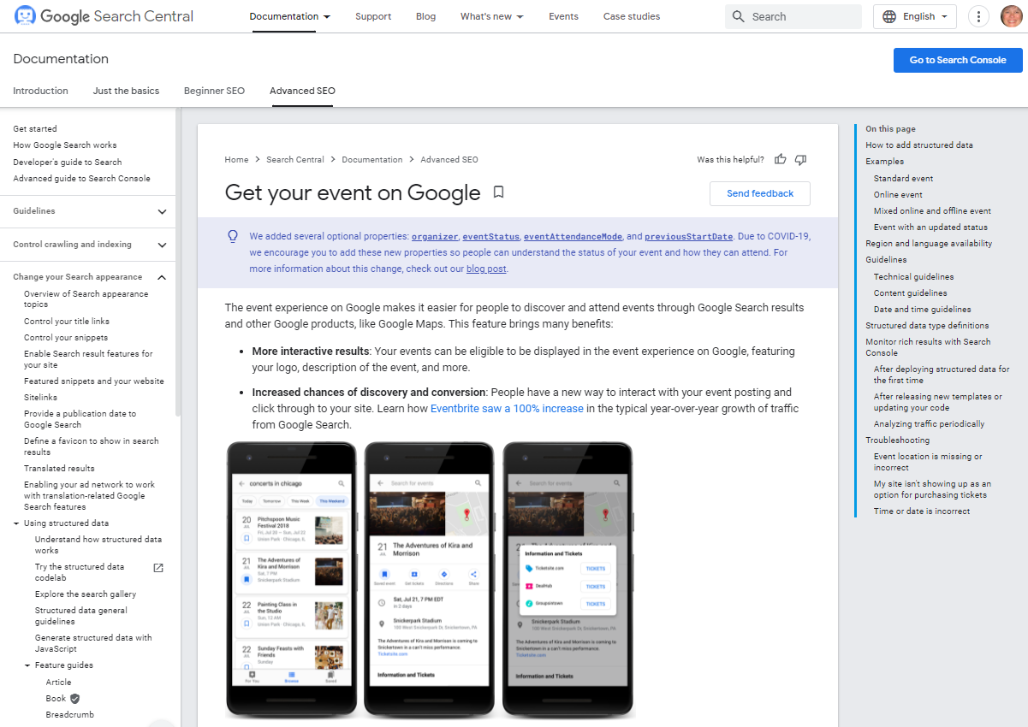
Google Events
Search What’s On in [your town, your region, your province]
Consider the results
Event info on Google

Slide 9
Three options to have events eligible for Google Events
You use Third-Party site to post your events
Content Management System running your site has plug-ins
Edit HTML on your page

Slide 10
Third parties that integrate with Google Events
Eventbrite’s SEO started using structured data for events in 2015
Participated in Google’s search experience for events on mobile when it launched in May 2017
Facebook Events also show up
https://developers.google.com/search/case-studies/eventbrite-case-study
No Google Events structured data results for TicketMaster, Theatre Manager, AudienceView

Slide 11
Nakai Theatre in Whitehorse
Squarespace site
Events appear in Google Events
Has coded some schema.org structured data markup

Slide 12
Yukon Arts Centre
Do not have structured data on their site
Ticketing by Theatre Manager does not use structured data for events.
What’s Up Yukon uses structured data extensively and YAC adds complete event information
Might be using Google’s Data Highlighter to structure data

Slide 13
Google Data Highlighter
https://www.google.com/webmasters/data-highlighter/u/0/sources?siteUrl=https://digitalartsnation.ca/&hl=en_GB
Structured data markup stored within Google’s tool and is only available to Google
Does not change anything on your actual website

Slide 14
DIY Web CMS
Do-It-Yourself Content Management System – WordPress, Weebly, Squarespace, Wix – look for the ways in which you can add structured data for your events, courses, workshops, artists, organization, e.g. WordPress plug ins, or in Wix there is a place to put JSON-LD code.
There are three dominant formats for structuring your data:
JSON-LD (JavaScript Object Notation for Linking Data)
Microdata
RDFa (Resource Description Framework in Attributes)

Slide 15
WIX
https://support.wix.com/en/article/adding-structured-data-markup-to-your-sites-pages-2546962
WIX Store already has preset structured data
Wix only accepts structured data using JSON-LD markups.
Advance SEO tab
Structured Data Markup
Add New Markup

Slide 16
WordPress Plug-Ins Demo
Based on research by Jai Djwa in 2020 for CAPACOA, the best combination of WordPress plugins he found was:
Yoast for SEO
SchemaPro
Modern Events Calendar Lite
https://thepitch.ca/wp-admin/post.php?post=663&action=edit
https://thepitch.ca/info-session-sept-21-2021-making-awesome-pitch-videos/

Slide 17
Demo Sample Modern Events Calendar Light
https://thepitch.ca/wp-admin/post-new.php?post_type=mec-events

Slide 18
Schema.org markup templates
https://schema.org/Event
https://schema.org/Festival
https://www.schema.org/TheaterEvent
https://schema.org/MusicEvent
https://schema.org/Person
https://schema.org/CreativeWork

Slide 19
JSON-LD Mark up generators
https://technicalseo.com/tools/schema-markup-generator/
https://www.rankranger.com/schema-markup-generator
https://seosmoothie.com/free-seo-tools/schema-markup-generator/event

Slide 20
Testing your mark up
https://validator.schema.org/
Google recommends to test your structured data using the Rich Results Test during development, and the Rich result status reports after deployment, to monitor the health of your pages.

Slide 21
DigitalArtsNation.ca Digital Playbook
https://digitalartsnation.ca/digital-playbook/mastering-discoverability-for-the-performing-arts/
https://digitalartsnation.ca/digital-playbook/mastering-discoverability-for-the-performing-arts/structured-data-how-to-enhance-discoverability/

Slide 22
Beyond Fundamentals
Assess Advanced SEO: January 12
Machine-readable content: January 15 or 19
Wikidata: January 26
Review/Practice:
January 29 or February 2

Slide 23
LET’S STAY IN TOUCH
Inga Petri
Strategic Moves
Whitehorse, Yukon
www.strategicmoves.ca
ipetri@strategicmoves.ca
613.558.8433 (mobile, Canada-wide)
@ipetri

