Slide 1
Workshop 2 Creating Web Content that Connects with Your Audience
Created and presented by
Inga Petri, Strategic Moves
October 25, 2021
1 pm to 2:15 pm Eastern

Slide 2
We live on the traditional territories of many Indigenous peoples
who have cared for this land since time immemorial.
Specifically, the Oneida and Chippewa Nations of the Thames, Kettle Point and Stony Point, and the Saugeen and Munsee Delaware Nations, are the traditional custodians of the land from which SpringWorks/Hermione Presents operates.
Strategic Moves operates on the Traditional Territories of the
Ta’an Kwäch’än Council and Kwanlin Dün First Nation,
self-governing nations that negotiated modern treaties (2002; 2005)
under the Umbrella Final Agreement between the 14 Yukon First Nations
and the Governments of Canada and Yukon.
Notes:
Replace with specific acknowledgement for the presenter – ie Montreal and workshops location

Slide 3
Notes:
Standard project slide for background and promote project website

Slide 4
P.A.D.E Workshop Series (2021 – 2022)
Fundamentals
Assessment: October 18 or 23
Website content: October 25
Social media content: November 1
Mastering Google: November 29
Review/Practice: December 4
Beyond Fundamentals
Assess Advanced SEO: January 12
Machine-readable content: January 15 or 19
Wikidata: January 26
Review/Practice:
January 29 or February 2
Digital Business / Revenue
Digital Value Chain: February 16 or 19
Hybrid Business Models: February 23
Digital Business Tools / Revenue Streams: March 9

Slide 5
Homework Review
What do you want to accomplish with your website?
Who are your target audiences? Be specific about demographics (e.g. age, life stage, location) or psychographics (values, attitudes, beliefs)
What do you want your target audience to do on your website?
What does your target audience want from your web site?
How well does your current web content take into consideration what your audience wants?

Slide 6
Understand your audiences, motivations
Who is your target audience?
What do
they want?
What do you
want them
to do?
2 to 3
User cases, task-based

Slide 7
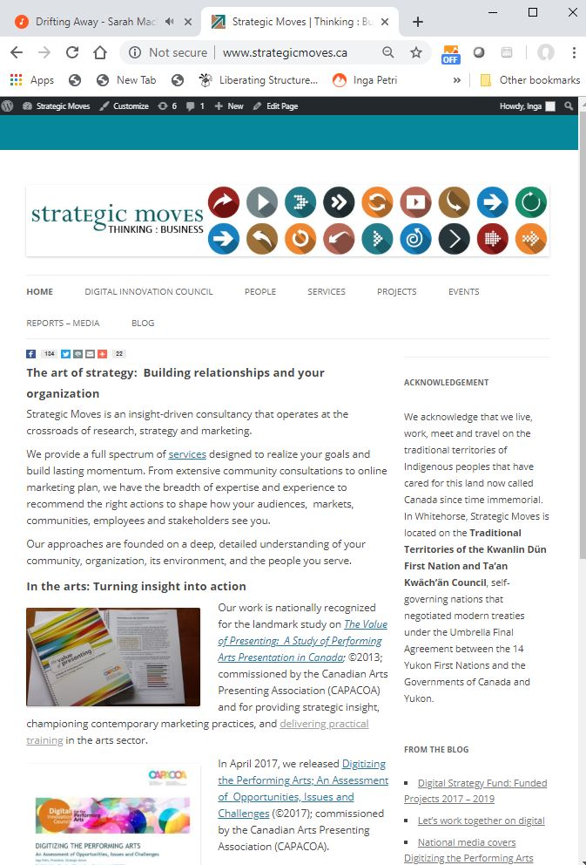
Website info determines search result
Notes:
10:50

Slide 8
Understanding and Meaning
How machines read
How humans read
www

Slide 9
Writing your web site for people
Authentic voice
Connect your purpose with audience motivations
Start with 8 to 12 important keywords
Balance: interesting read that flows well with consistent keywords
Second tier keywords important in body text, because first tier keywords dominant in structure
Make the page easy to scan
Consistent headings and short paragraphs
Editorial use of images, video
Minimize ‘features’ in body text, like colour, bold, underline, italics; they make reading harder

Slide 10
Great website writing
Hook reader from the first line (start with the punch line)
Find and use your voice
Don’t need to explain your art, show it (imagery and video)
Don’t need to justify your art, be it fully
Don’t tell me how I’ll feel, invite me in
Write clearly – easy to understand, easy to scan
Read it out loud
Help me navigate
Tell reader what to do (call-to-action)

Slide 11
Traditional SEO Coding for Search Engines
URL (uniform resource locator) = web address
Use words not acronyms or numbers
URL page names
Each service / product / experience on own page
Use relevant keywords
Title tags
Appears on browser tab
Search engine uses them as the header in search listings
Facebook does, too
Headlines (h1 tag imperative)
Image Alt tags
Use the “image ALT” text for keyword-rich descriptive text
Description meta tag
This is a real summary sentence for a specific page
Search engines, and other sites, can use them in result displays
Fast load times (no high res images, no autoplay videos)
SSL encryption (secure socket layer)
Sitemap.xml and robot.txt
Notes:
Demonstrate DigitalArtsNation and ThePitch, Strategic Moves – re interplay of Yoast SEO and Text, Images

Slide 12
Demonstration – DigitalArtsNation.ca

Slide 13
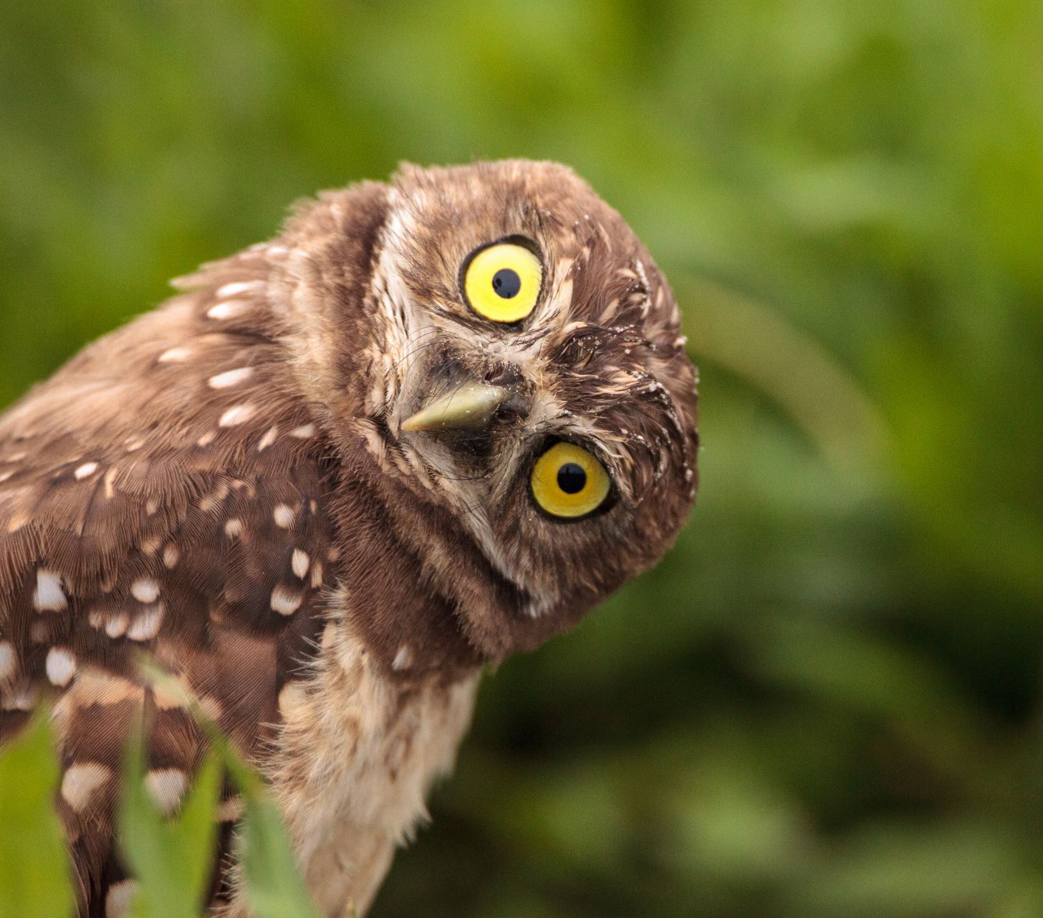
Writing Process and Elements
Keywords (users use to search)
Page URL – domain.ca/keyword-rich-page-url
Title tag – keyword rich formula
H1 – main theme for the page
Headlines
Body text
Editorial imagery (still or video) with IMG ALT texts
Once text is final, update keywords as needed before publishing

Slide 14
Fundamentals
Assessment: October 18 or 23
Website content: October 25
Social media content: November 1
Mastering Google: November 29
Review/Practice: December 4
Week 1: Digital Inclusion
Week 2: The Emerging Digital Performing Arts eco-system
Week 3: Ways forward and Digital Technologies to Watch

Slide 15
LET’S STAY IN TOUCH
Inga Petri
Strategic Moves
Whitehorse, Yukon
www.strategicmoves.ca
ipetri@strategicmoves.ca
613.558.8433 (mobile, Canada-wide)
@ipetri

